Slide 1


Slide 2
Agenda
Introduction to hashing
Types of hashing
Indexing Vs Hashing

Slide 3
Introduction to Hashing
For a huge database structure, it's tough to search all the index values through all its level and then you need to reach the destination data block to get the desired data.
Hashing technique is used to calculate the direct location of a data record on the disk without using index structure.
Faster method to search data

Slide 4
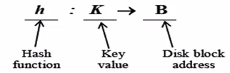
Important Terminologies
Data bucket – Data buckets are memory locations where the records are stored.
Hash function: A hash function, is a mapping function which maps all the set of search keys to the address where actual records are placed.
This hash function can also be a simple mathematical function like exponential, mod, cos, sin, etc.
Bucket Overflow: The condition of bucket-overflow is called collision.

Slide 5
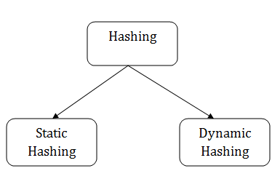
Types of Hashing

Slide 6
Static Hashing
In static hashing, when a search-key value is provided, the hash function always computes the same address.
For example, if mod-4 hash function is used, then it shall generate only 5 values. The output address shall always be same for that function.
The number of buckets provided remains unchanged at all times.

Slide 7
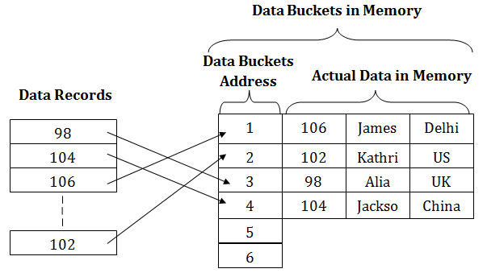
Hash function (h) = k mod 5

Slide 8
Operations
Insertion − When a record is required to be entered using static hash, the hash function h computes the bucket address for search key K, where the record will be stored.
Bucket address = h(K)
Search − When a record needs to be retrieved, the same hash function can be used to retrieve the address of the bucket where the data is stored.
Delete − This is simply a search followed by a deletion operation.

Slide 9
Collision
The condition of bucket-overflow is known as collision.
If we want to insert some new record into the file but the address of a data bucket generated by the hash function is not empty, or data already exists in that address. This situation in the static hashing is known as bucket overflow.
This is a critical situation in this method.
To overcome this situation, there are two methods namely:
  Open Hashing or Linear Probing
  Closed Hashing or Overflow Chaining

Slide 10
Collision Resolution
Linear Probing − When a hash function generates an address at which data is already stored, the next free bucket is allocated to it. This mechanism is called Open Hashing.
Overflow Chaining − When buckets are full, a new bucket is allocated for the same hash result and is linked after the previous one. This mechanism is called Closed Hashing.

Slide 11
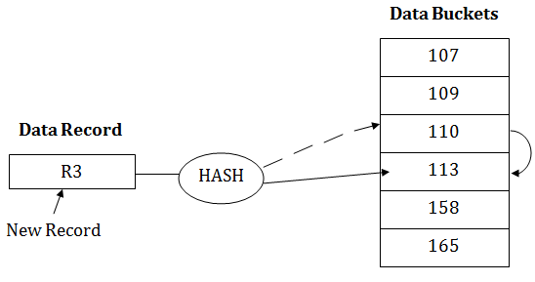
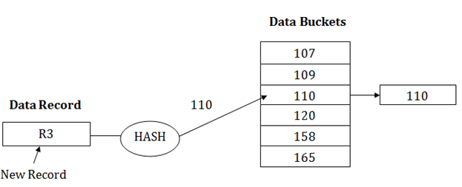
Linear Probing Overflow Chaining

Slide 12
Dynamic Hashing
The problem with static hashing is that it does not expand or shrink dynamically as the size of the database grows or shrinks.
Dynamic hashing provides a mechanism in which data buckets are added and removed dynamically and on-demand.
Each result of hash function is represented in binary, called Hash value.
Records are distributed among the buckets based on the values of the leading bits in their hash value.
Types
  Extendible Hashing
  Linear Hashing

Slide 13
Extendible Hashing
This scheme stores a directory structure in addition to the file.
This access structure is based on the result of the hash function to the search key.
Advantage: No additional space is wasted towards the allocations of new records.
Overhead: Directory structure need to be searched before the buckets are accessed.

Slide 14
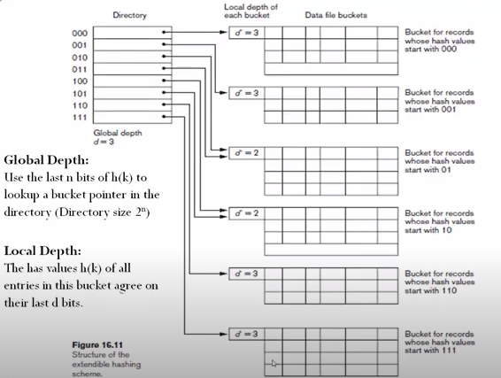
Extendible Hashing..

Slide 15
Example
Hashing Example.docx

Slide 16
Linear Hashing
No directory structure is used.
Instead of single hash function, multiple hash functions are used.
When collision occurs with one hash function, the bucket that overflows is split into two and the records in the original bucket are distributed among two buckets using the next hash function h_{i+1}(k).

Slide 17
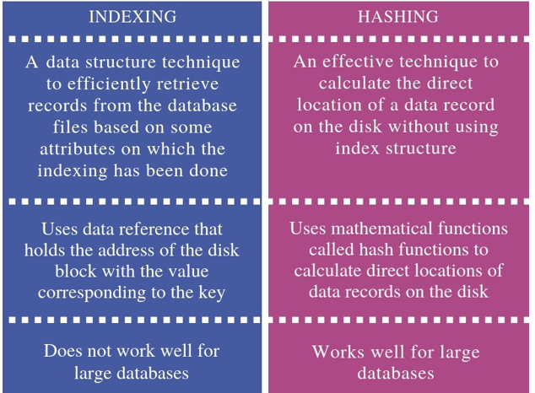
Indexing Vs Hashing

Slide 18


